Slide 1
Machine Learning Analysis on KDD99 Dataset

Slide 2
Introduction
In this project, we have used machine learning algorithms for KDD99 for cyber attack detection. We will be using supervised machine learning techniques and neural network model to train and build multiple classification models that can classify attack type of network traffic versus normal type of network traffic. Then we will compare the accuracies of the multiple classification models.

Slide 3
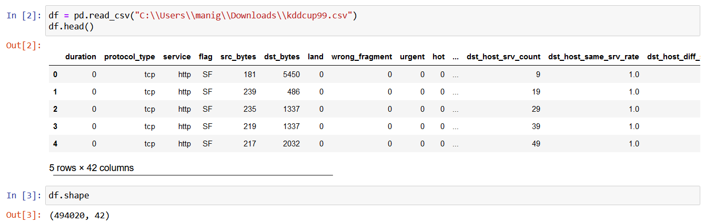
Importing the dataset
The following code reads the KDD99 CSV dataset into a Pandas data frame.
The dataset has 42 unique features and 494020 samples.

Slide 4
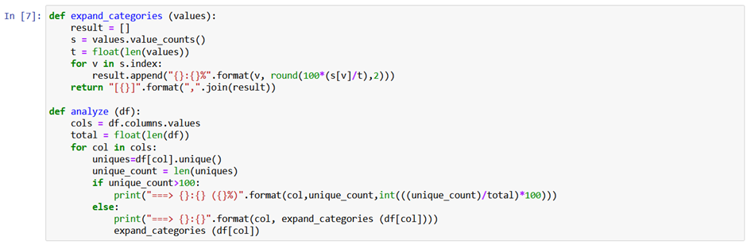
Analysing the data
We are analyzing the data by looking at the unique values present in the dataset by calling analyze() function. For example, the duration column has 2495 unique values, and there is a 0% overlap. We have displayed the percentage of the unique value in the column if the number of unique values is less than 100 to save display space. This is done by the expand_categories() function. For example, a text or categorical feature such as protocol_type only has a few unique values, and the program shows the percentages of each category. Finally, to be on the safer side, we checked whether there are any null values or not.

Slide 5
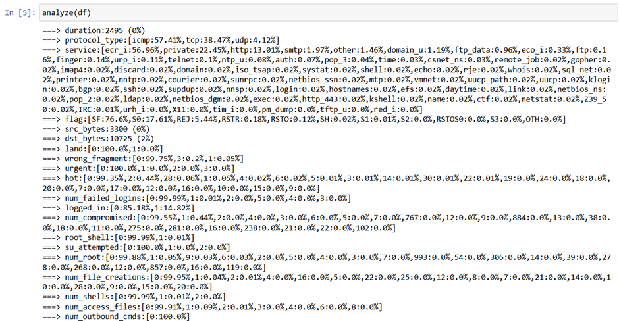
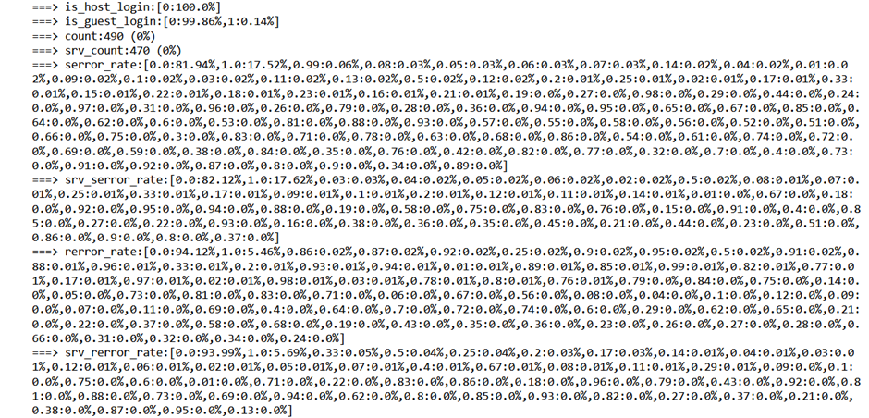
Analysing the data (Contd.)

Slide 6
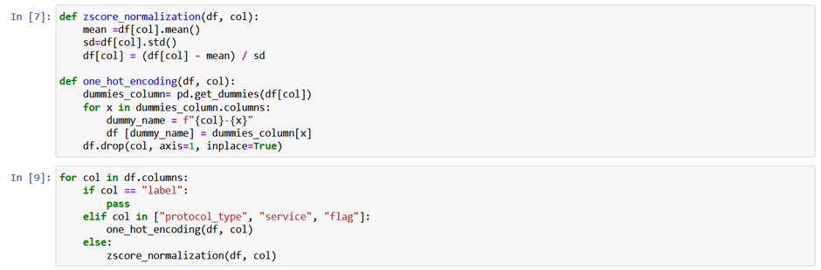
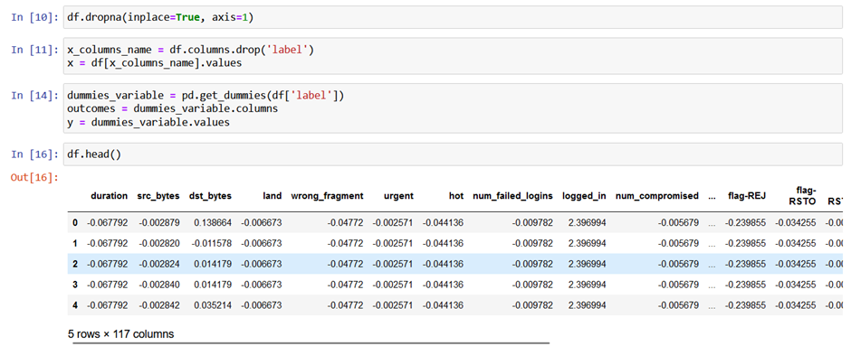
Preprocessing the data
In this dataset, we have text data in protocol_type, service and flag. So we are using one hot encoding to convert text to numerical input. Since we have different ranges of input we should normalize it. We are normalizing the data using Z - Score.
Z - Score normalization is done using zscore_normalization() function and one hot encoding is done by one_hot_encoding(). Then we are dropping the records which have null values. Then one hot encoding is done for the outcome variable also and it is assigned to y. Variables other than outcome are assigned to x.

Slide 7
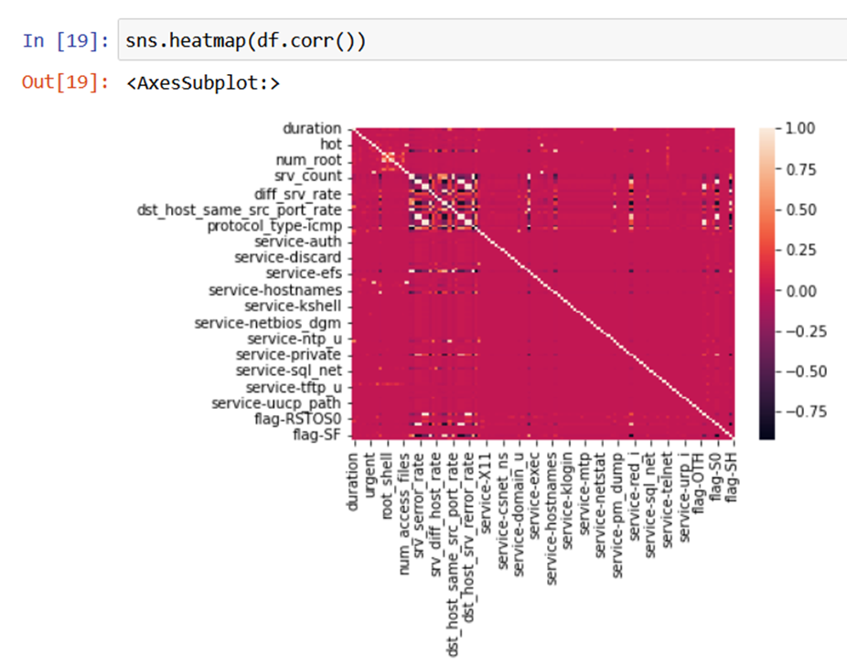
Heatmap
From the heatmap which is derived based on correlation between two features, we can see that there are no two features which has high correlation.

Slide 8
Initial Classification
Initially, We are splitting the dataset into train data (75% and test data (25%).
After that, we trained models using the sci-kit library. Next, we will print the classification matrix which tells about recall, accuracy, precision and f1-score for each target variable and the average of above mentioned scores also. Then, we will print the confusion matrix of Precited Vs Truth values of target variables. Finally, we are printing the accuracy of the model.
We will be training Decision Tree and Random Forest model.
We didn’t use Naïve Bayes and Logistic Regression because we have used one hot encoding on target variable and we have 23 columns at the end which makes it difficult to fit into the algorithm and we avoided KNN algorithm because of its very high runtime. We will have very high runtime because it’s a Lazy predictor and we have many columns and 370515 samples in training dataset which increases the runtime exponentially.

Slide 9
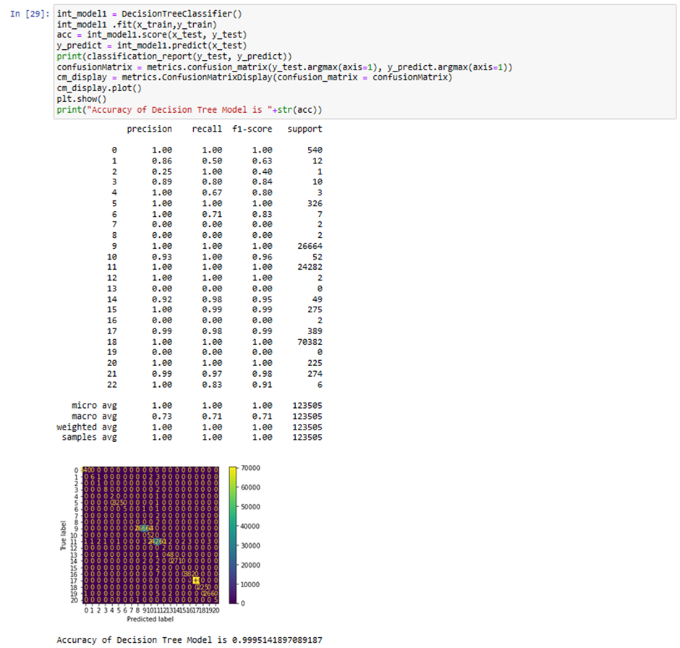
Initial Classification – Decision Tree
We trained a decision tree model and we can see that we have got an accuracy of 99.9514% and we can also see recall, precision and f1 score.

Slide 10
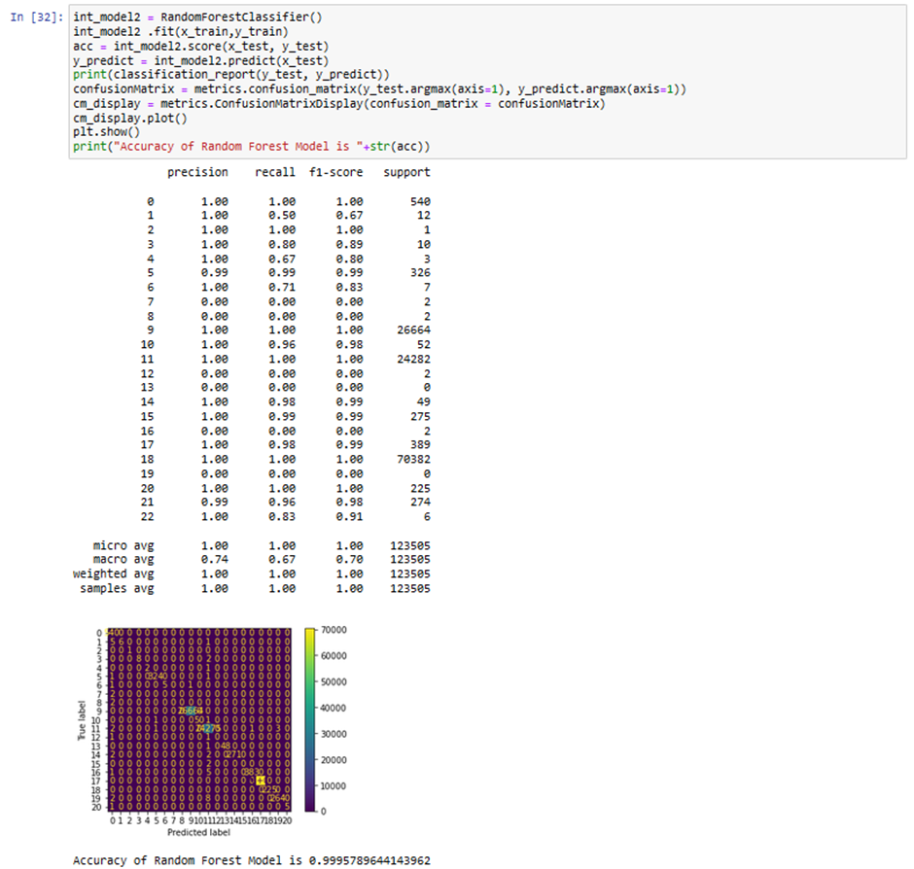
Initial Classification – Random Forest
We trained a random forest model and we can see that we have got an accuracy of 99.9578% and we can also see recall, precision and f1 score.

Slide 11
Optimizing the model
We optimize the model through two ways:-
1. Feature Extraction
2. Hyper parameter tuning using Randomized Search CV

Slide 12
Feature Extraction
We are optimizing the model by extracting the important features since we might have many unwanted features which doesn’t contribute in classification and those might mislead the model. For feature extraction, we are exploiting a feature available in decision tree algorithm. The decision tree library provides a feature to calculate importance of each feature while training the model. In the following image, we are training a decision tree model on the whole dataset without splitting and we are using feature_importance_ feature to get importance of each feature and we are storing inn imp variable.

Slide 13
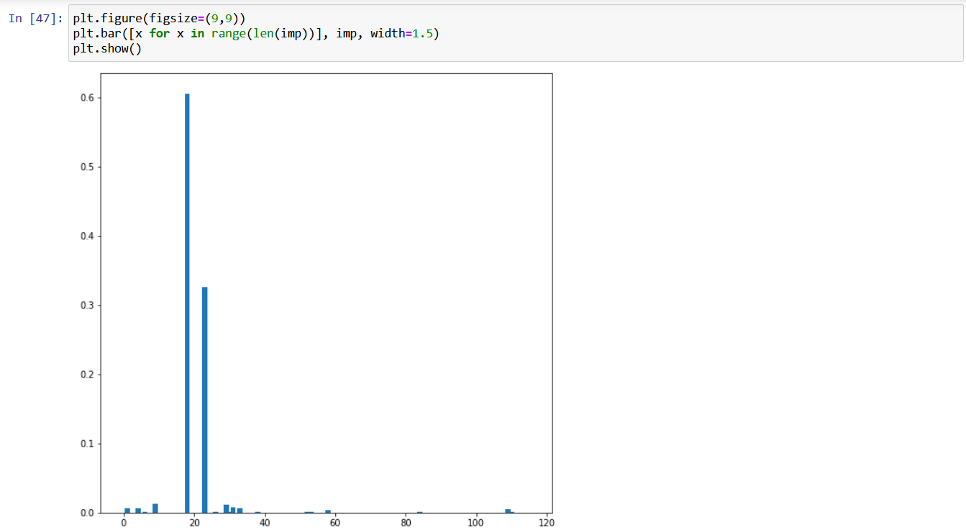
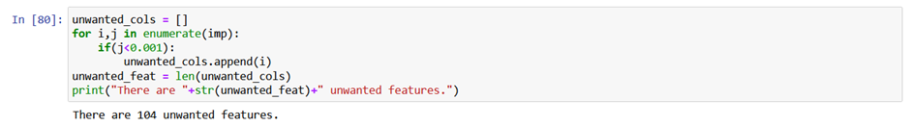
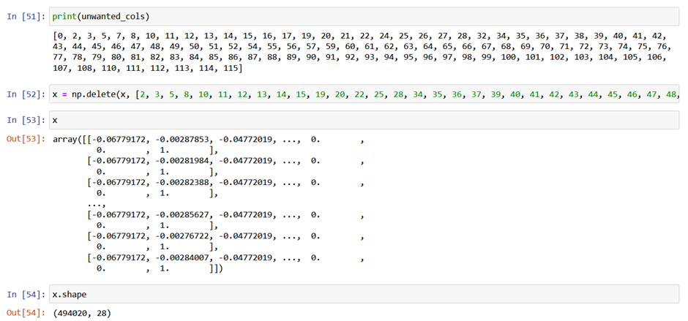
Feature Extraction (Contd.)
After that, we are plotting a bar chart based on imp variable.
Finally, we are removing the unwanted features which has
importance less than 0.001. We have 28 features at the end.

Slide 14
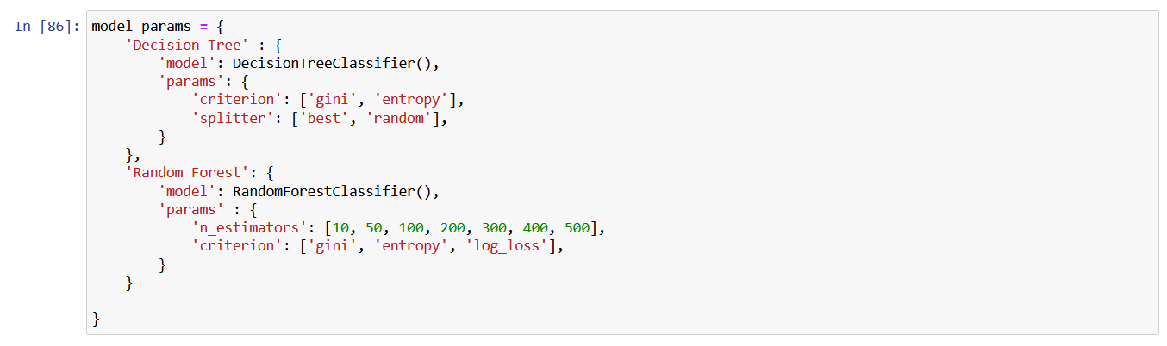
Hyperparameter tuning using Randomized Search CV
For hyperparameter tuning, in order to automate this process of trying different combinations of hyperparameters, we will be using Randomized Search CV. First, we will be creating a JSON object which contains the models along with the parameters which e will be using to train the model.
We will be inputting this JSON object to RandomizedSearchCV() which trains each of the model in JSON using for loop with different combination of parameters. Once it trains, we are appending model name, best training score, parameters that gave the best accuracy and accuracy of the model into a data frame. Based on the scores1 data frame, we are training the best model.

Slide 15
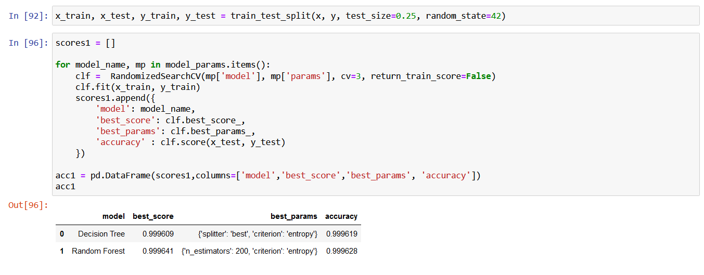
Training models using Randomized Search CV (After Optimization)
Here, we can see that we are getting an accuracy of 99.9641% for Random forest model and 99.9609% for Decision tree model which is higher than the non optimized models.

Slide 16
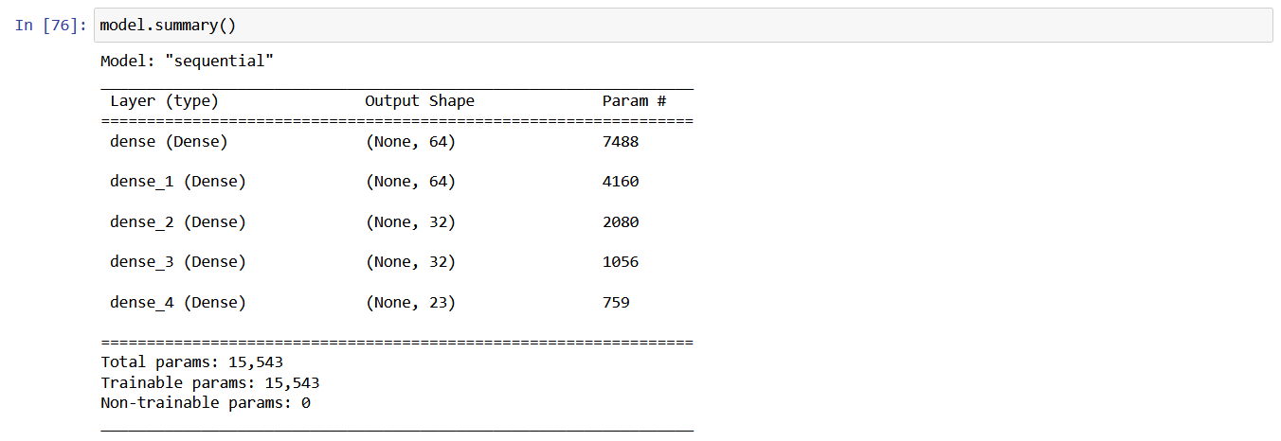
Artificial Neural Network (ANN) Model
We developed an artificial neural network which is sequential. We added one input layer with 116 neurons since we have 116 input features, four hidden layers with ReLU as activation layer with 64 or 32 neurons and one output layer with softmax as activation layer with 23 neurons because we have 23 classes (which is derived after applying one hot encoding on the target variable). We have used adam optimizer to reduce the loss and categorical_crossentropy as a cost function to calculate the loss.
The architecture of the ANN model is as follows:

Slide 17
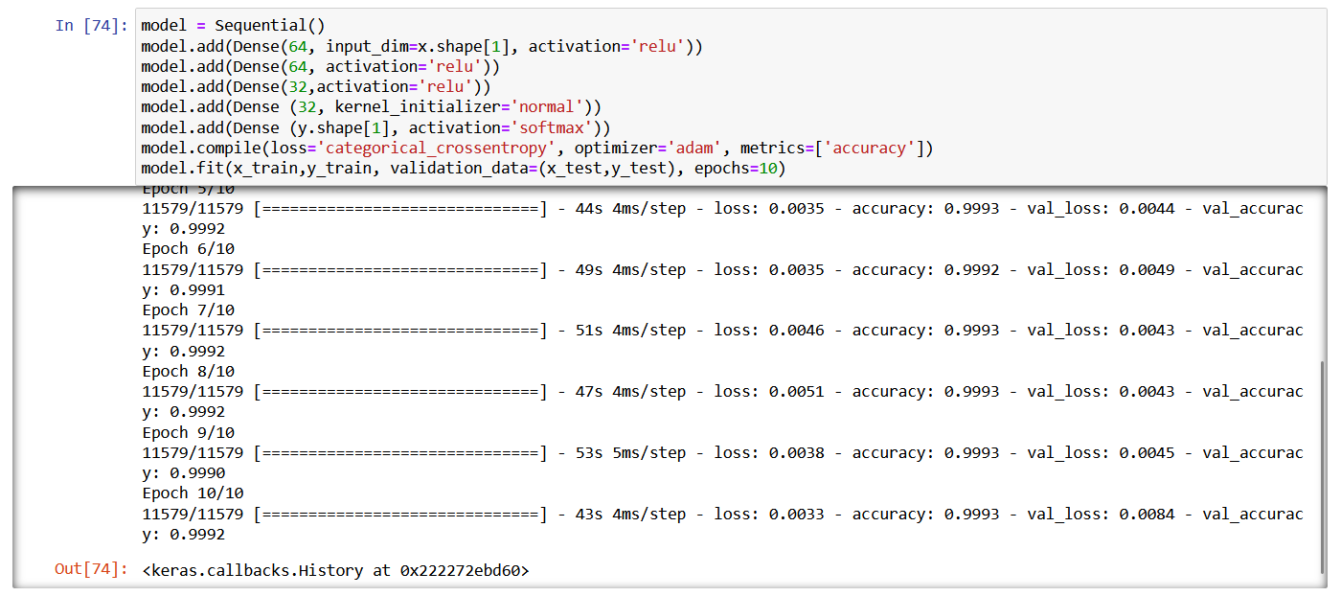
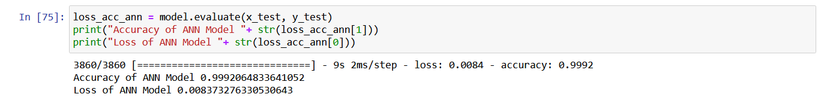
Artificial Neural Network (ANN) Model (Contd.)
We have got an accuracy of 99.920% which is really good for an ANN model and a loss value of 0.837% which is really low and its negligible.

Slide 18
Conclusion
After optimizing the models using Feature extraction and Hyper parameter tuning, we get a highest accuracy of 99.9641% for Random Forest model and 99.9609% for Decision tree model. So, we can conclude that Random Forest model gives the highest accuracy when comparing both the models with the parameters: n_estimators: 200 and criterion: entropy and therefor it’s the best model.
Thus, for detecting cyber attacks. Random Forest is the best model which can used by training on the above mentioned parameters using KDD99 dataset.

Slide 19
Thank
You !

